Slide 1
Conditional Statements And Control Statements

Slide 2
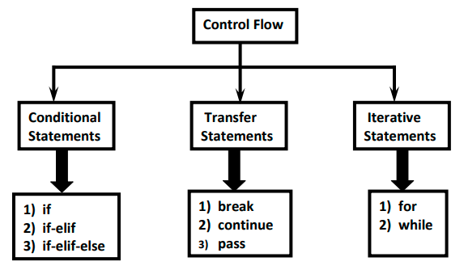

Slide 3
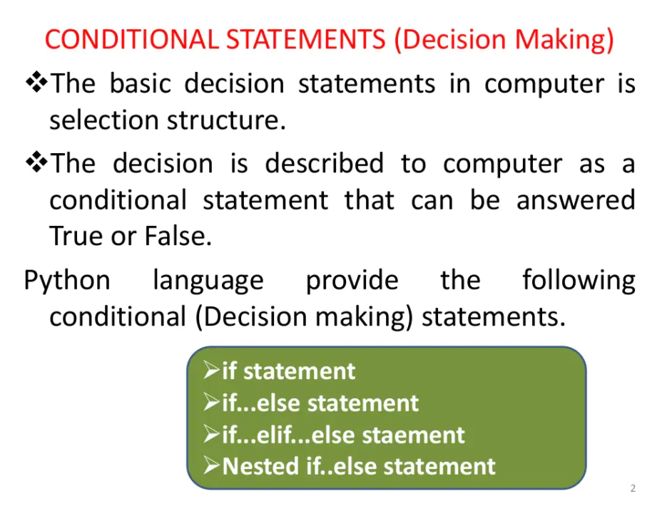

Slide 4
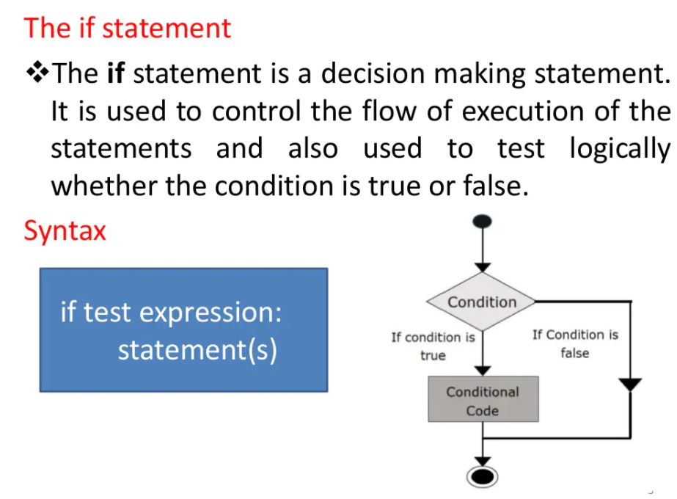

Slide 5
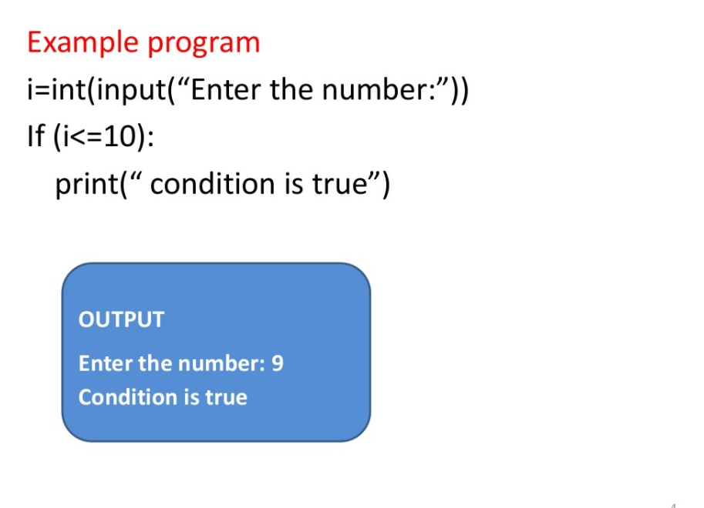

Slide 6
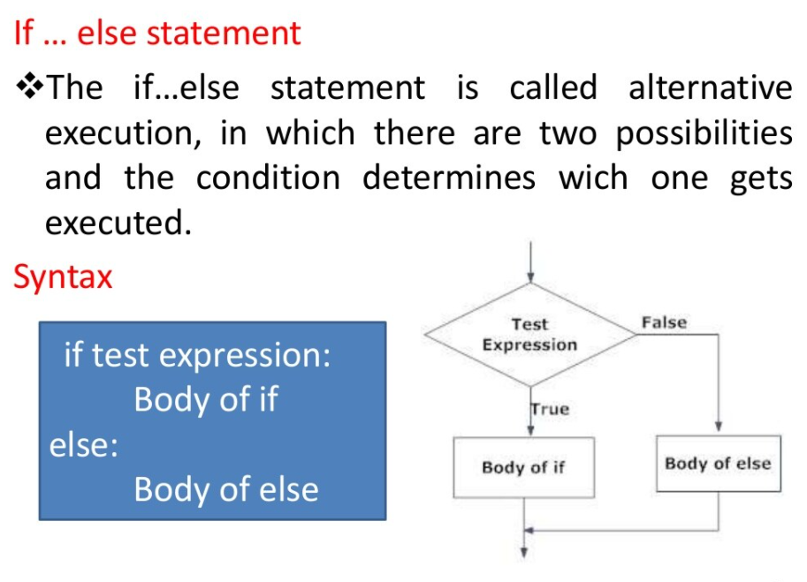

Slide 7
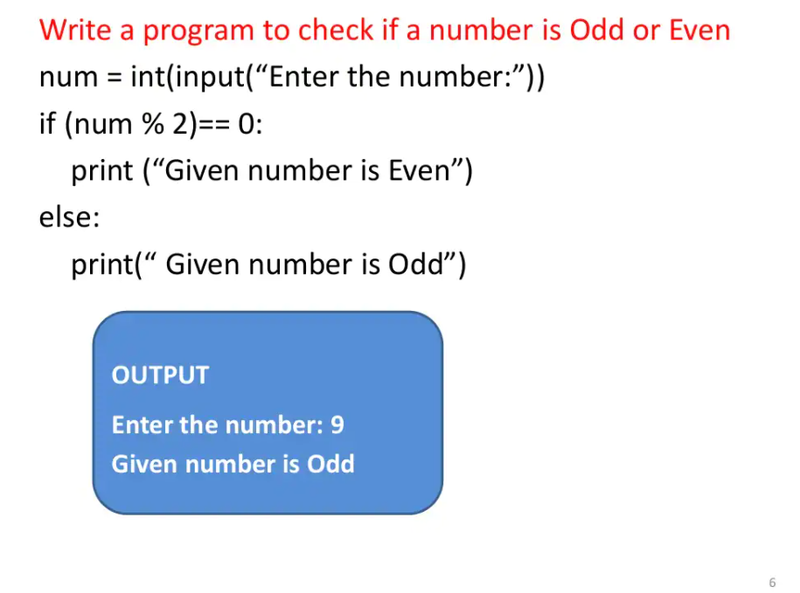

Slide 8
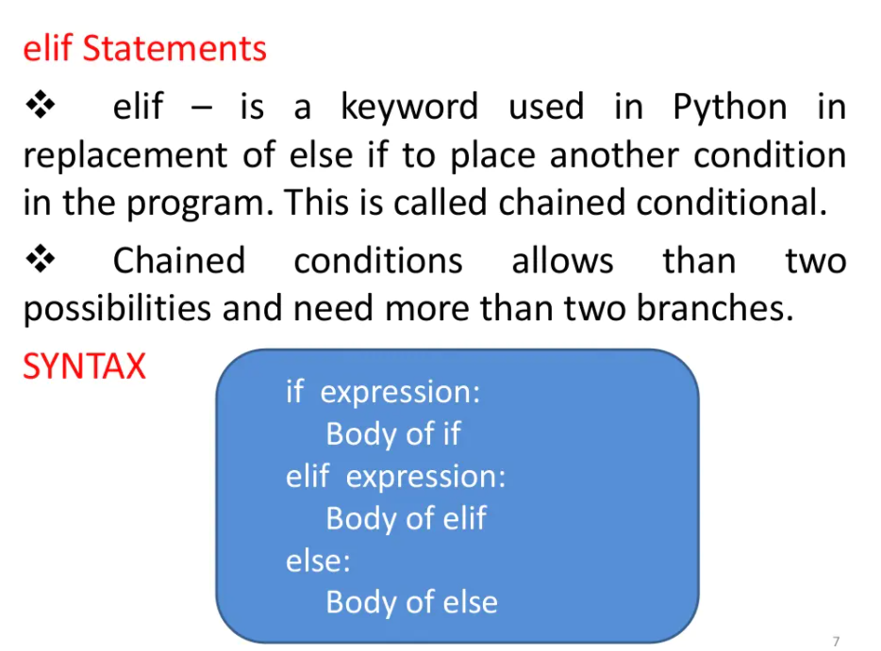

Slide 9
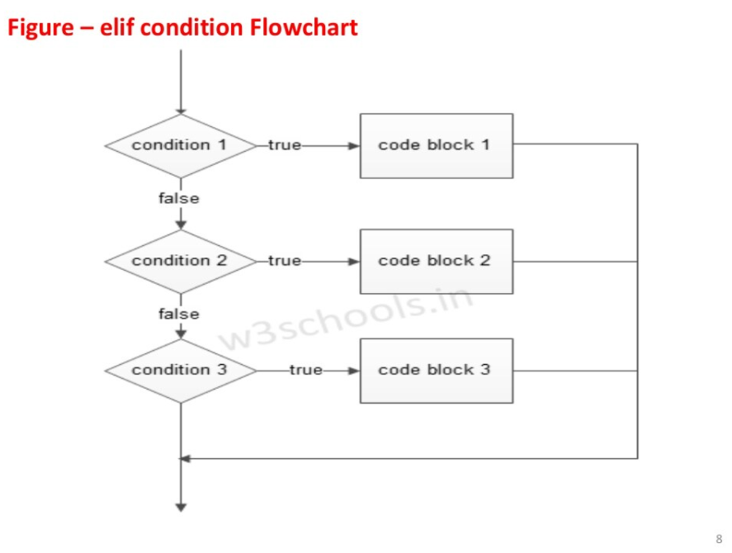

Slide 10
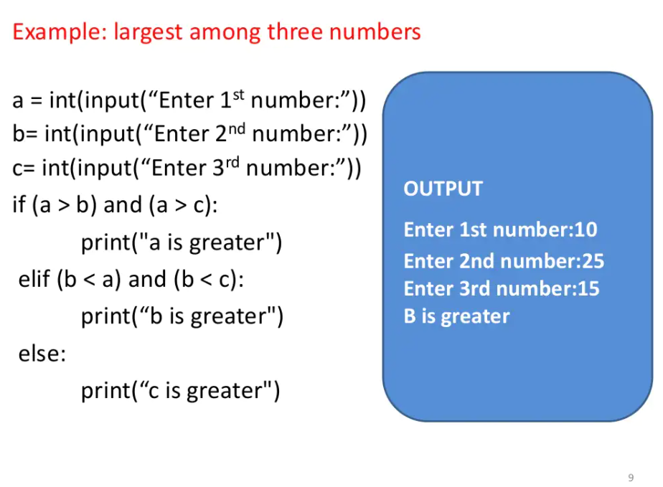

Slide 11
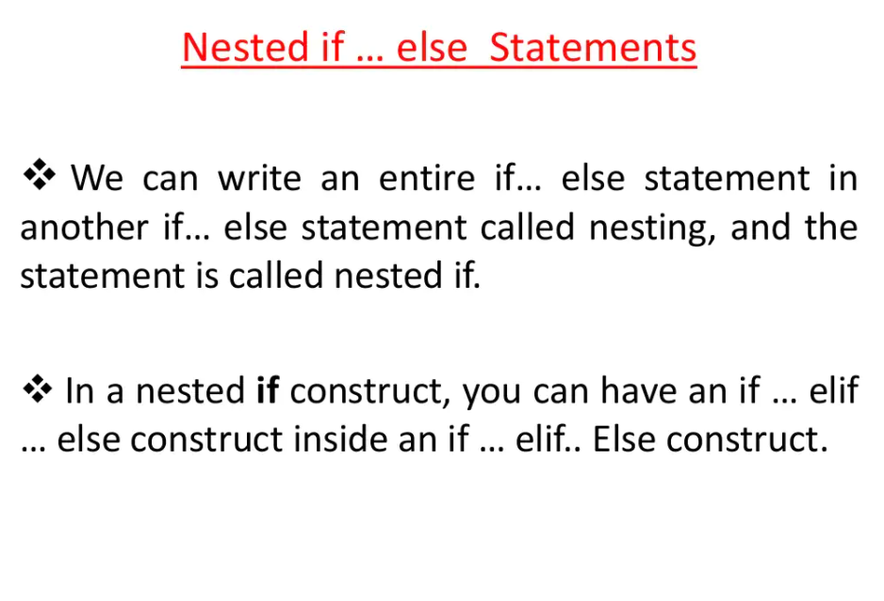

Slide 12
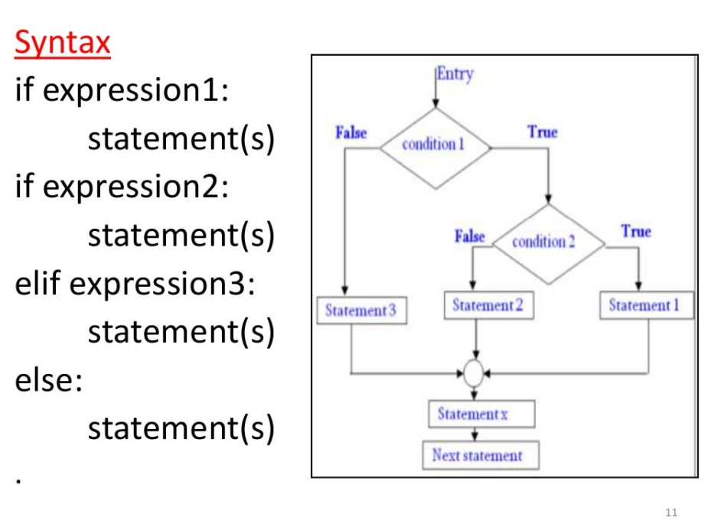

Slide 13
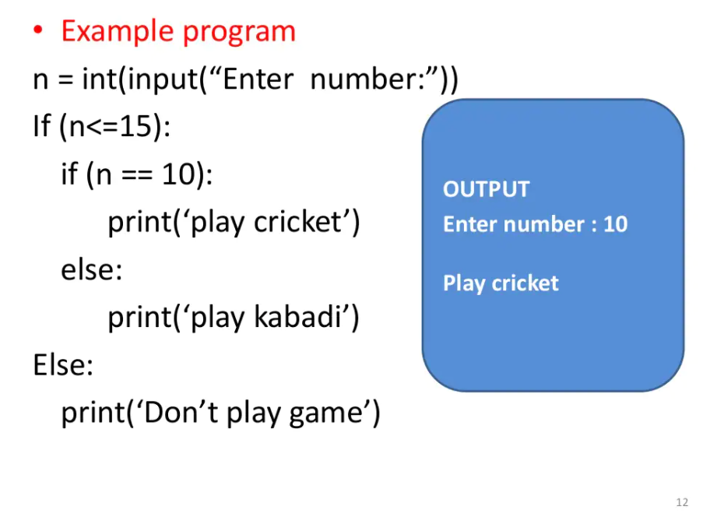

Slide 14
Questions
Take input of age of 3 people by user and determine oldest and youngest among them.
A school has following rules for grading system: a. Below 25 - F b. 25 to 45 - E c. 45 to 50 - D d. 50 to 60 - C e. 60 to 80 - B f. Above 80 - A Ask user to enter marks and print the corresponding grade.

Slide 15
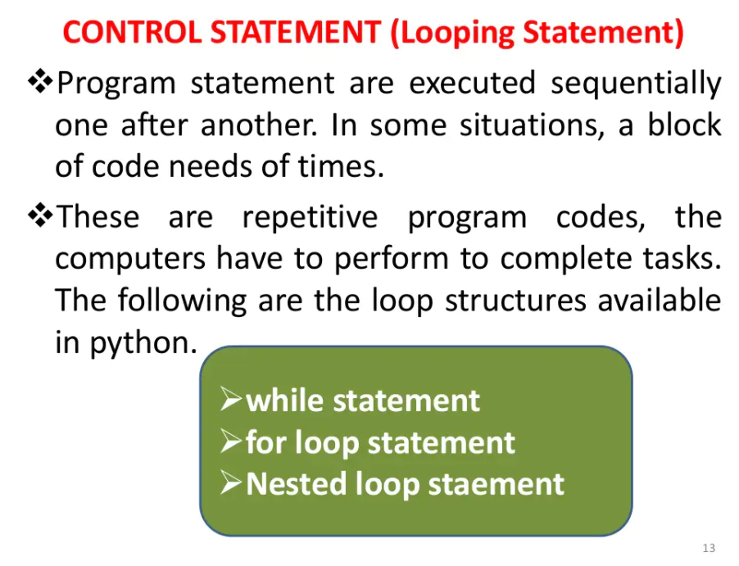

Slide 16
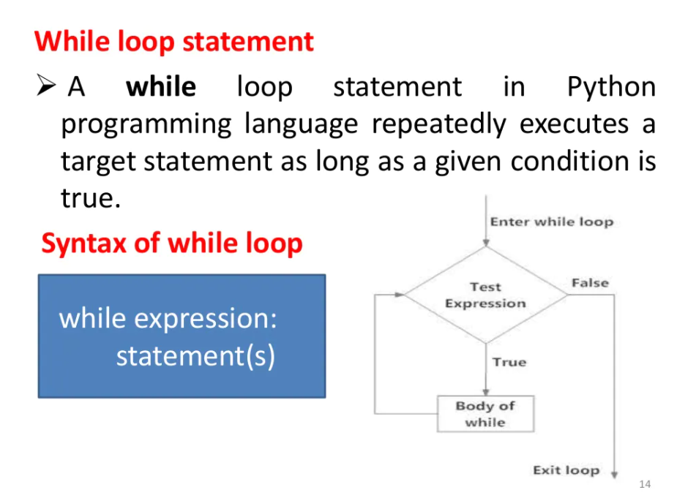

Slide 17
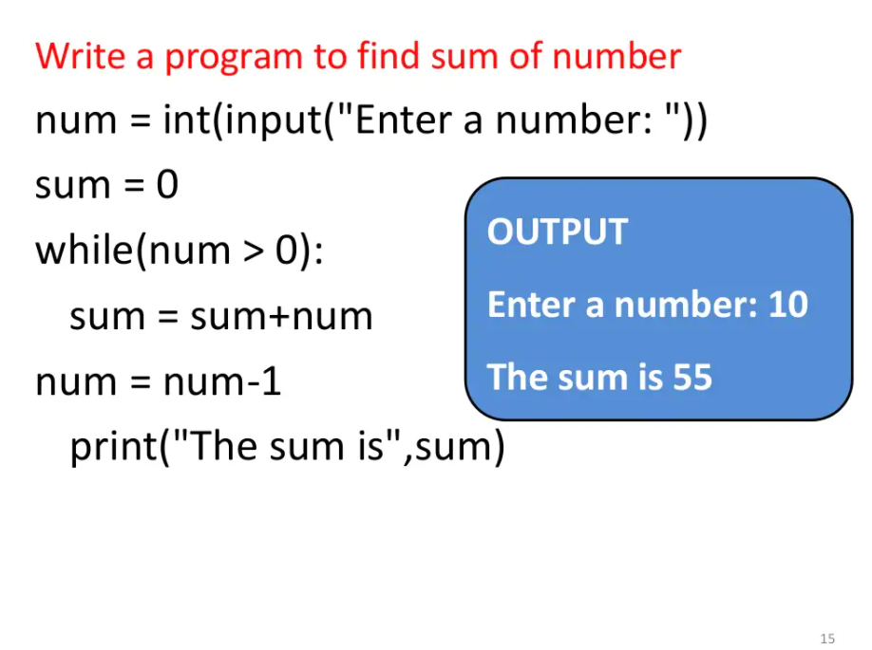

Slide 18
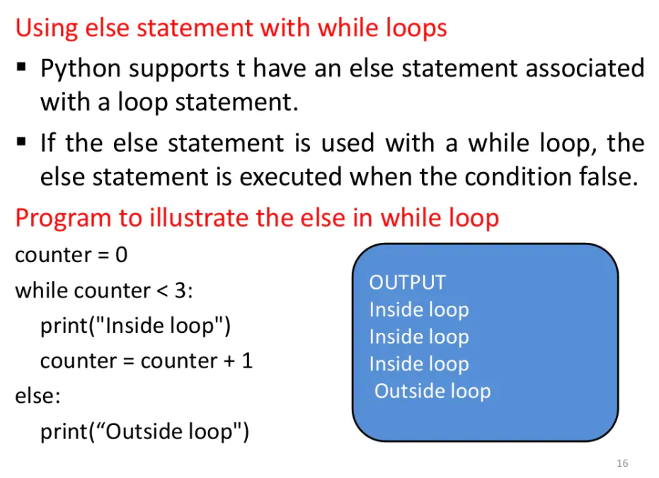

Slide 19
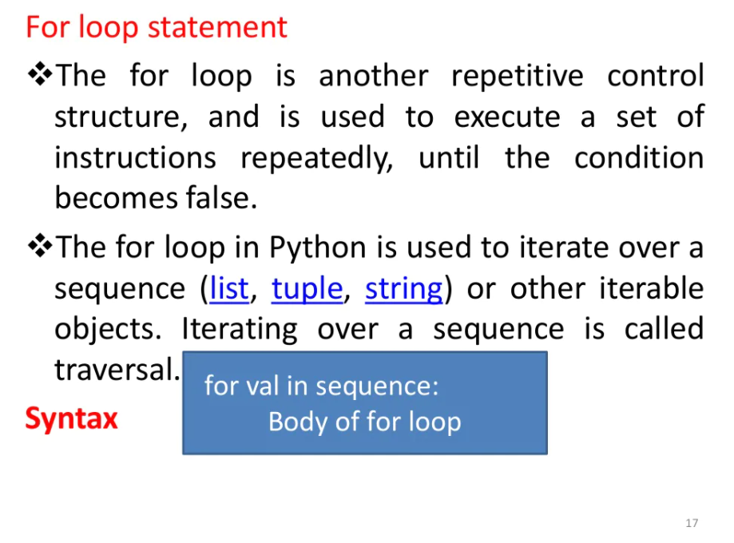

Slide 20
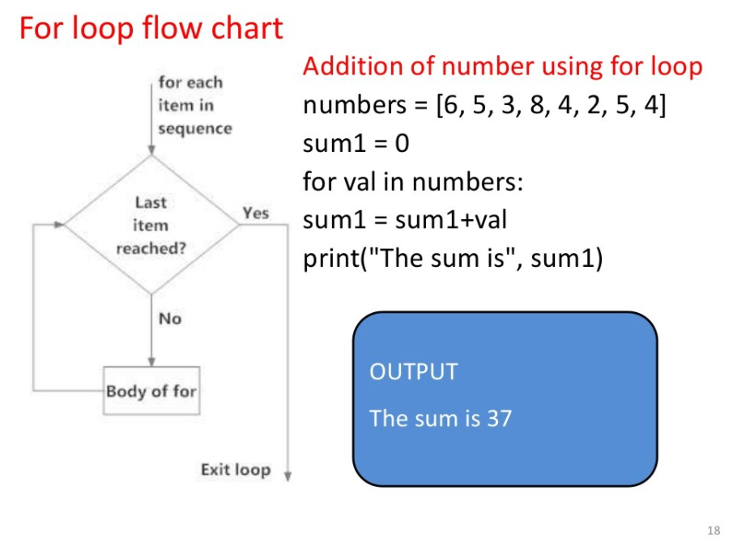

Slide 21
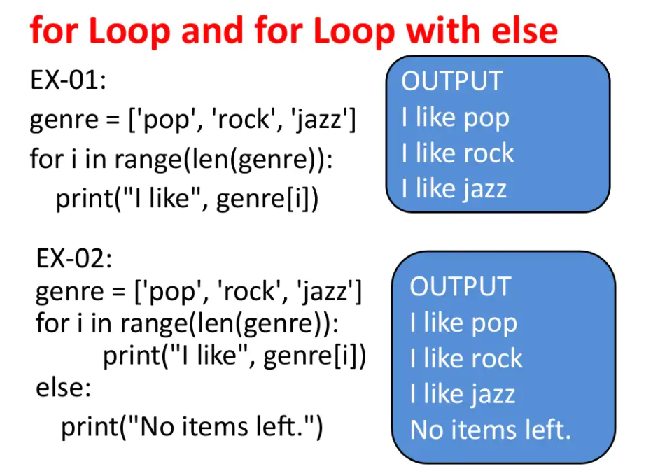

Slide 22
Questions
Write a program to print first 10 natural number.
Write a program to print first 10 even numbers.
Write a program to print first 10 odd numbers.
Write a program to print first 10 even numbers in reverse order.
Write a program to check whether a number is prime or not.

Slide 23
Python Program to Check if a Number is a Palindrome
n=int(input("Enter number:"))
temp=n
rev=0
while(n>0):
dig= n%10
rev=rev*10+dig
n=n//10
if(temp==rev):
print("The number is a palindrome!")
else:
print("The number isn't a palindrome!")

Slide 24
Break and Continue in Python

Slide 25
The use of break and continue in Python
In Python, break and continue statements can alter the flow of a normal loop.
Loops iterate over a block of code until the test expression is false
but sometimes we wish to terminate the current iteration or even the whole loop without checking test expression.
The break and continue statements are used in these cases.

Slide 26
Python break statement
The break statement terminates the loop containing it.
Control of the program flows to the statement immediately after the body of the loop.
If the break statement is inside a nested loop (loop inside another loop), the break statement will terminate the innermost loop.
Syntax of break
break

Slide 27
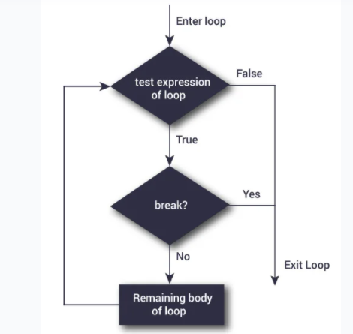
Flowchart of break

Slide 28
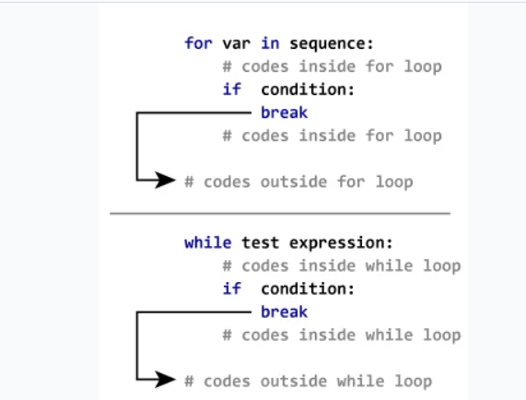
working of break statement

Slide 29
Example: Python break
# Use of break statement inside the loop
for val in "string":
if val == "i":
break
print(val)
print("The end")

Slide 30
Python continue statement
The continue statement is used to skip the rest of the code inside a loop for the current iteration only.
Loop does not terminate but continues on with the next iteration.
Syntax of Continue
continue

Slide 31
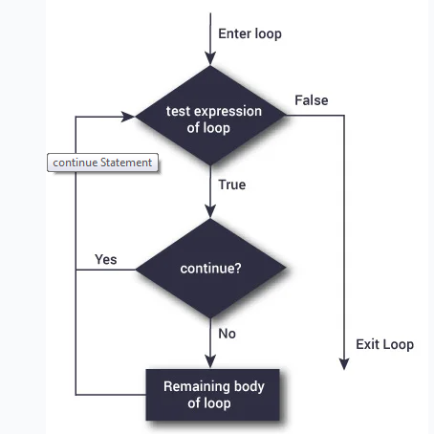
Flowchart of continue

Slide 32
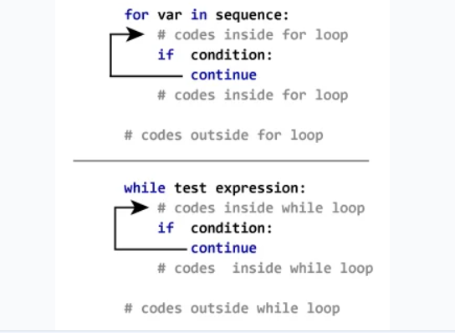
working of the continue statement in for and while loop is shown below.

Slide 33
Example: Python continue
for val in "string":
if val == "i":
continue
print(val)
print("The end")

Slide 34
Pass statement in Python
In Python, pass is a null statement.
The interpreter does not ignore a pass statement, but nothing happens and the statement results into no operation.
The pass statement is useful when you don’t write the implementation of a function but you want to implement it in the future. So, to avoid compilation errors, you can use the pass statement.

Slide 35
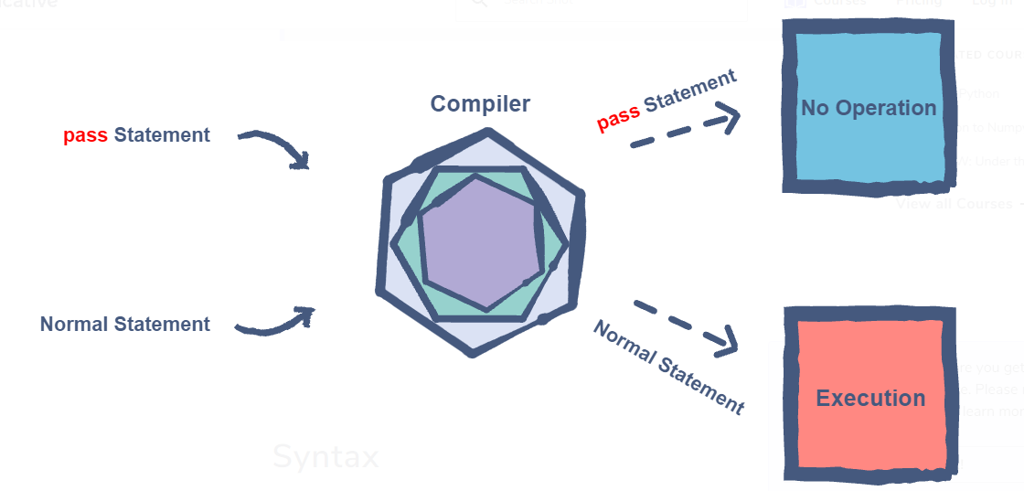
Working Syntax pass

Slide 36
Writing a function with no body
def addition(num1, num2):
# Implementation will go here
pass # Pass statement
addition(2, 2)

Slide 37
Ignoring an if statement implementation
def display(number):
if number is 2:
pass # Pass statement
else:
print ("Number: ", number)
display(2)
display(3)

Slide 38
Examples

Slide 39
The working example using break statement is as shown below:
my_list = ['Siya', 'Tiya', 'Guru', 'Daksh', 'Riya', 'Guru']
for i in range(len(my_list)):
print(my_list[i])
if my_list[i] == 'Guru':
print('Found the name Guru')
break
print('After break statement')
print('Loop is Terminated')

Slide 40
Example: Break statement inside while-loop
my_list = ['Siya', 'Tiya', 'Guru', 'Daksh', 'Riya', 'Guru']
i = 0
while True:
print(my_list[i])
if (my_list[i] == 'Guru'):
print('Found the name Guru')
break
print('After break statement')
i += 1
print('After while-loop exit')

Slide 41
Example: Break Statement inside nested loops
for i in range(4):
for j in range(4):
if j==2:
break
print("The number is ",i,j);

Slide 42
Example : Continue inside for-loop
for i in range(10):
if i == 7:
continue
print("The Number is :" , i)

Slide 43
Example : Continue inside while-loop
i = 0
while i <= 10:
if i == 7:
i += 1
continue
print("The Number is :" , i)
i += 1

Slide 44
Example: pass statement inside a function
def my_func():
print('pass inside function')
pass
my_func()

